Slide 1
Green Bus Ticketing System
Supervisor: Kiều Trọng Khánh
Members:
Đỗ Ngọc Hoàng - SE61246 – Team Leader
Trần Quang Trường – SE61129
Đoàn Minh Đức - SE61486

Slide 2
Overview
Introduction
Scenarios Problems
Team’s Proposal
Team’s Solution
Feature explanations and Demo
Advantages and Disadvantages
Future Plan

Slide 3

Introduction
Notes:
1. Tiết kiệm chi phí
2. Giảm ùn tắc giao thông
3. Hạn chế căng thẳng
4. Hạn chế được các tác động thời tiết bên ngoài
5. Có nhiều thời gian trò chuyện cùng bạn bè hơn

Slide 4

Introduction

Slide 5




1. Scenario Problems
Student A takes a bus to school.
FPT-University
Student A

Slide 6
Current Process
Student A
Notes:
Đi xe buýt mua vé trực tiếp
Lên xe
Mua vé từ nhân viên
Nhận vé từ nhân viên (có thế nhận tiền thừa)
=> Mất thời gian không hiệu quả và chủ động

Slide 7


Current Process
Staff B
1. Buy ticket
Student A
Notes:
Đi xe buýt mua vé trực tiếp
Lên xe
Mua vé từ nhân viên
Nhận vé từ nhân viên (có thế nhận tiền thừa)
=> Mất thời gian không hiệu quả và chủ động

Slide 8

Current Process
Staff B
1. Buy ticket
2. Receive ticket
Student A
Notes:
Đi xe buýt mua vé trực tiếp
Lên xe
Mua vé từ nhân viên
Nhận vé từ nhân viên (có thế nhận tiền thừa)
=> Mất thời gian không hiệu quả và chủ động

Slide 9

Current Process’s Problems
Current Process
- Prepare small changes
- Wait for staff to sell ticket
- Receive changes

Slide 10

Current Process’s Problems
Current Process
- Prepare small changes
- Wait for staff to sell ticket
- Receive changes
Problems
Waste a lot of time
Need a staff to sell ticket

Slide 11

Current Process’s Overview for monthly ticket
Bus Station / Office
Person A
Notes:
Sử dụng vé tháng
Muốn có vé tháng
Đến trụ sở hoặc bến xe để mua
Nhận 1 tập vé từ nhân viên
Lên xe buýt
Đưa vé tháng cho nhân viên
Nhận lại 1 vé xác nhận
=>

Slide 12
Current Process Overview for monthly ticket
Bus Station / Office
1. Buy monthly ticket
Person A
Notes:
Sử dụng vé tháng
Muốn có vé tháng
Đến trụ sở hoặc bến xe để mua
Nhận 1 tập vé từ nhân viên
Lên xe buýt
Đưa vé tháng cho nhân viên
Nhận lại 1 vé xác nhận
=>

Slide 13

Current Process Overview for monthly ticket
Bus Station / Office
1. Buy monthly ticket
2. Receive tickets
Person A
Notes:
Sử dụng vé tháng
Muốn có vé tháng
Đến trụ sở hoặc bến xe để mua
Nhận 1 tập vé từ nhân viên
Lên xe buýt
Đưa vé tháng cho nhân viên
Nhận lại 1 vé xác nhận
=>

Slide 14
Current Process Overview for monthly ticket
Bus Station / Office
1. Buy monthly ticket
3. Get on bus
2. Receive tickets
Person A
Notes:
Sử dụng vé tháng
Muốn có vé tháng
Đến trụ sở hoặc bến xe để mua
Nhận 1 tập vé từ nhân viên
Lên xe buýt
Đưa vé tháng cho nhân viên
Nhận lại 1 vé xác nhận
=>

Slide 15
Current Process Overview for monthly ticket
Bus Station / Office
Staff B
3. Get on bus
4. Give prepaid ticket to staff
1. Buy monthly ticket
2. Receive tickets
Person A
Notes:
Sử dụng vé tháng
Muốn có vé tháng
Đến trụ sở hoặc bến xe để mua
Nhận 1 tập vé từ nhân viên
Lên xe buýt
Đưa vé tháng cho nhân viên
Nhận lại 1 vé xác nhận
=>

Slide 16

Current Process Overview for monthly ticket
Bus Station / Office
Staff B
3. Get on bus
4. Give prepaid ticket to staff
1. Buy monthly ticket
2. Receive tickets
5. Receive bus ticket
Person A
Notes:
Sử dụng vé tháng
Muốn có vé tháng
Đến trụ sở hoặc bến xe để mua
Nhận 1 tập vé từ nhân viên
Lên xe buýt
Đưa vé tháng cho nhân viên
Nhận lại 1 vé xác nhận
=>

Slide 17
Monthly ticket process’s problems
Current Process
Go to station/office to buy tickets every month
Wait for staff to check ticket

Slide 18
Monthly ticket process’s problems
Current Process
Go to station/office to buy tickets every month
Wait for staff to check ticket
Problems
Waste of time to check
Cannot be refund when lost
One type of route

Slide 19
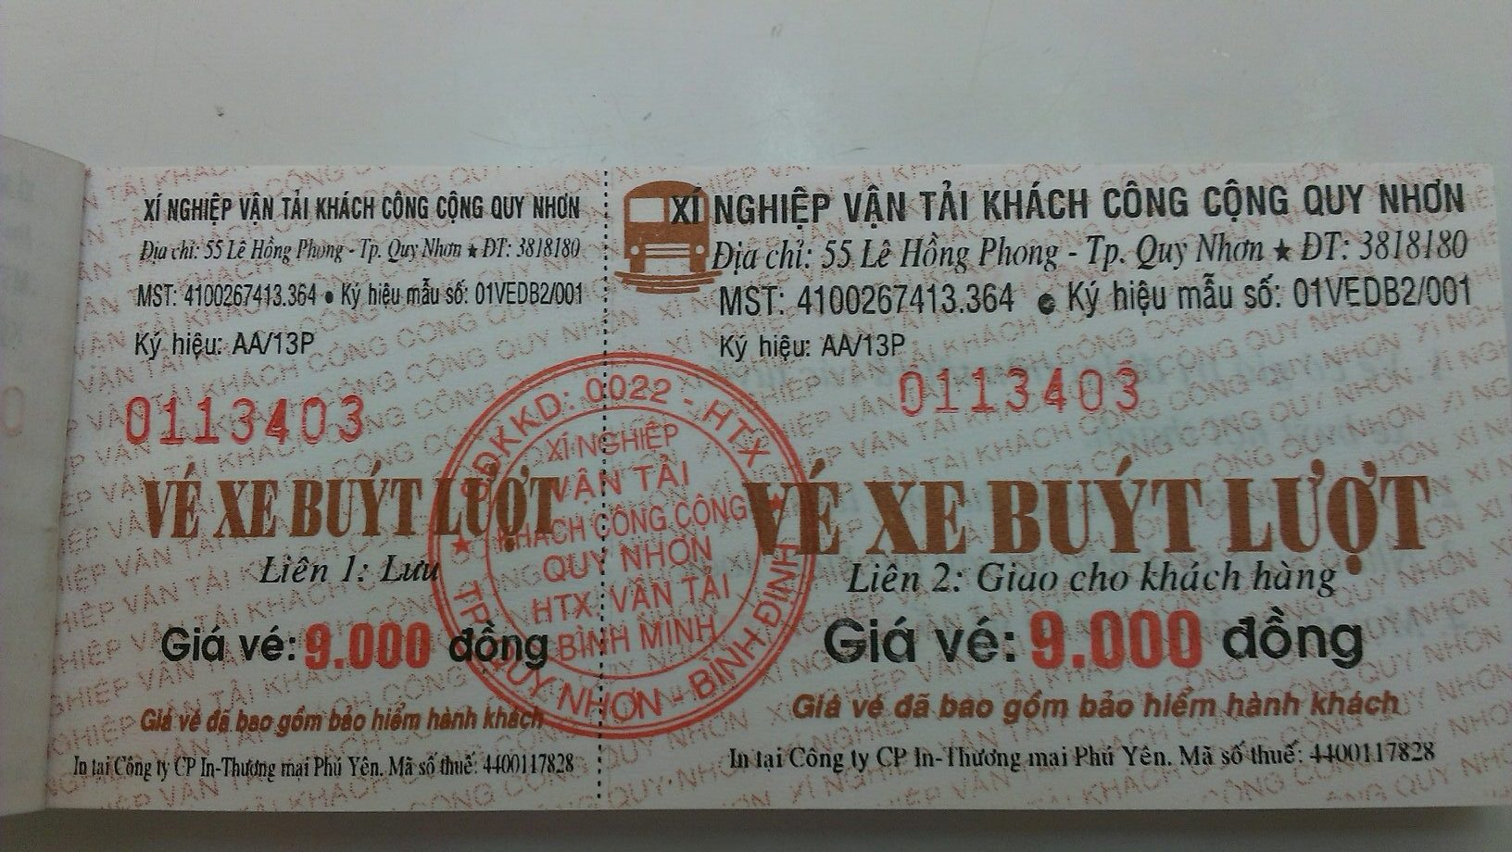
Ticket Material
Ticket is a paper
Notes:
Làm giả vé xe buýt

Slide 20
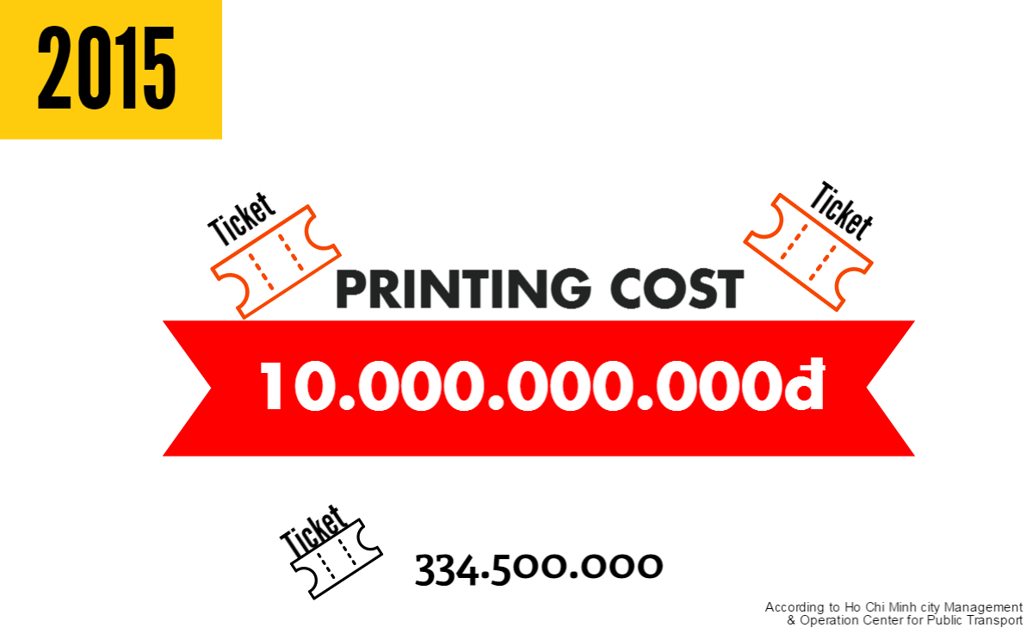
Ticket Material
Notes:
Làm giả vé xe buýt

Slide 21
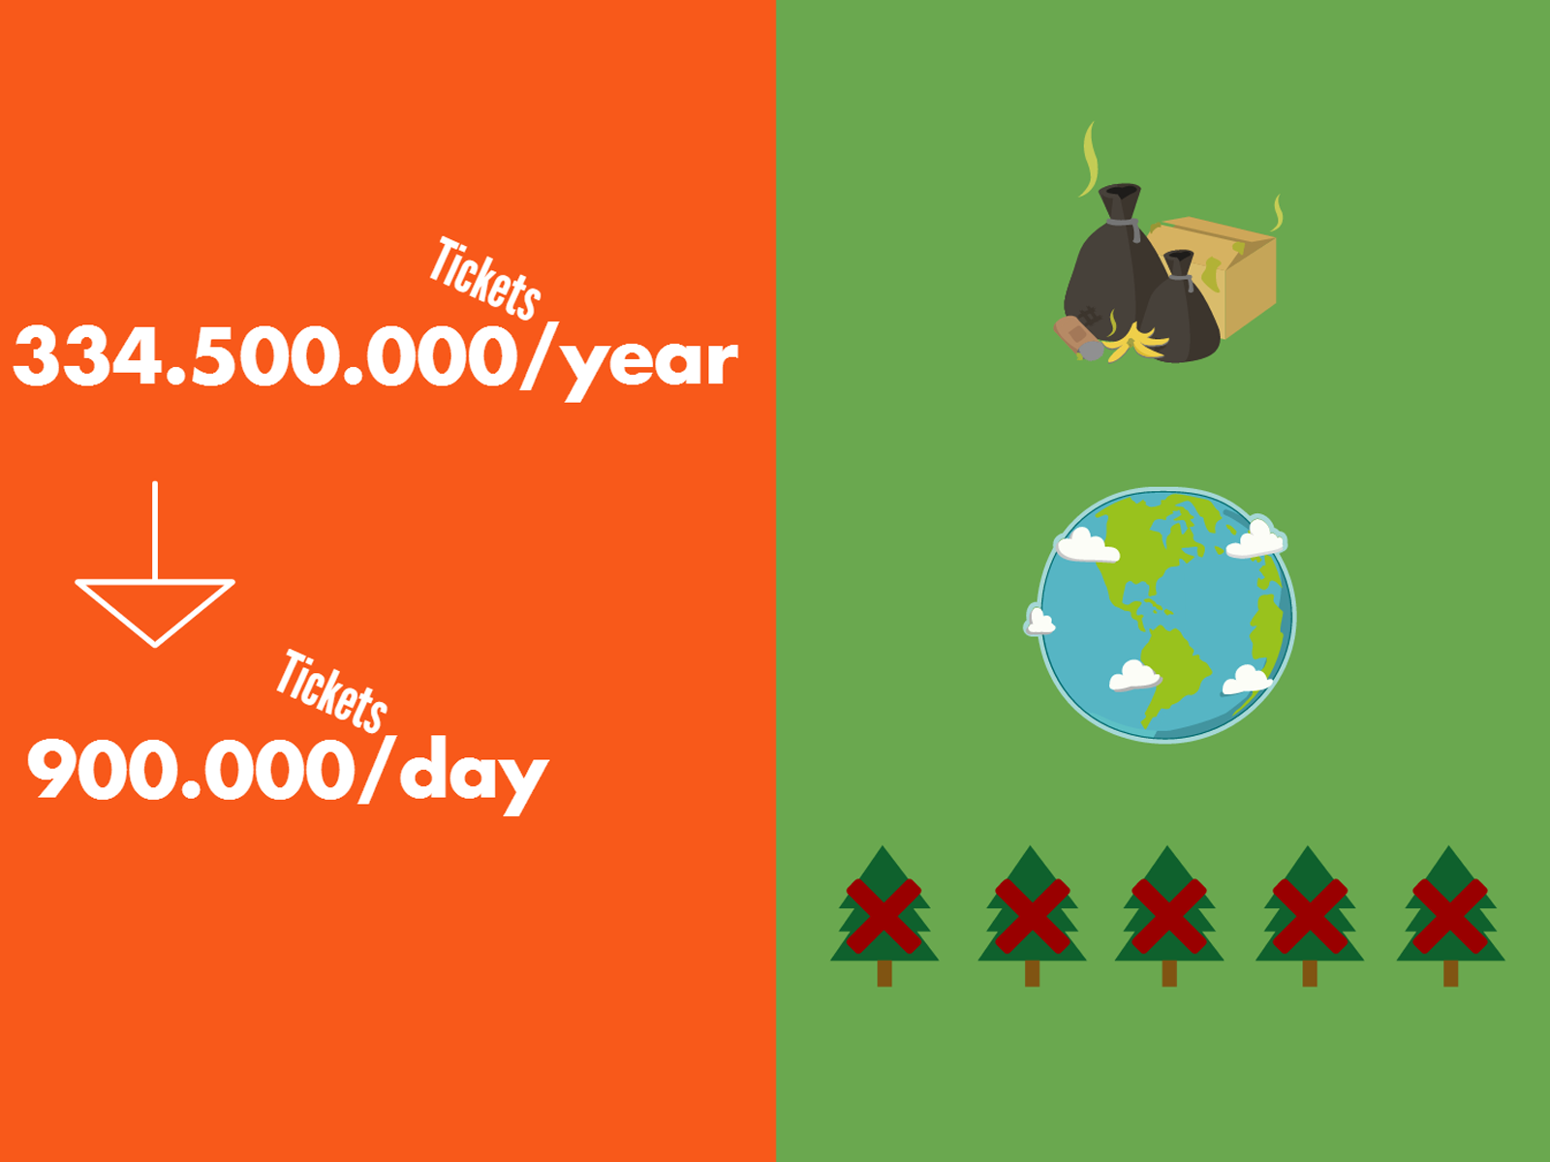
Notes:
Làm giả vé xe buýt

Slide 22
Ticket Material
Problems:
Printing cost
Not eco-friendly
Not reusable
Ticket is a paper
Notes:
Làm giả vé xe buýt

Slide 23
Current Process Overview
Bus Station / Office
Staff B
3. Get on bus
4. Give prepaid ticket to staff
1. Buy monthly ticket
2. Receive tickets
5. Receive bus ticket
Student A
Notes:
Sử dụng vé tháng
Muốn có vé tháng
Đến trụ sở hoặc bến xe để mua
Nhận 1 tập vé từ nhân viên
Lên xe buýt
Đưa vé tháng cho nhân viên
Nhận lại 1 vé xác nhận
=>

Slide 24
Our Process
Bus Station / Office
Staff B
3. Get on bus
4. Give prepaid ticket to staff
1. Buy monthly ticket
2. Receive tickets
5. Receive bus ticket
Student A
Notes:
Sử dụng vé tháng
Muốn có vé tháng
Đến trụ sở hoặc bến xe để mua
Nhận 1 tập vé từ nhân viên
Lên xe buýt
Đưa vé tháng cho nhân viên
Nhận lại 1 vé xác nhận
=>

Slide 25
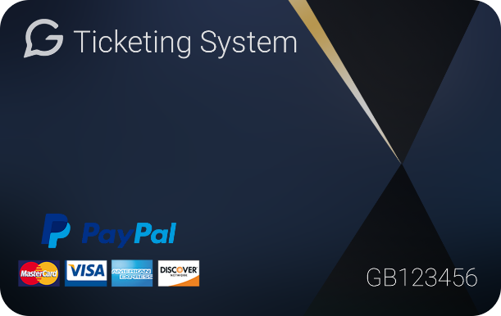
Our Process
Bus Station / Office
Staff B
3. Get on bus
4. Give prepaid ticket to staff
1. Buy card
2. Receive card
5. Receive bus ticket
Student A
Notes:
Sử dụng vé tháng
Muốn có vé tháng
Đến trụ sở hoặc bến xe để mua
Nhận 1 tập vé từ nhân viên
Lên xe buýt
Đưa vé tháng cho nhân viên
Nhận lại 1 vé xác nhận
=>

Slide 26
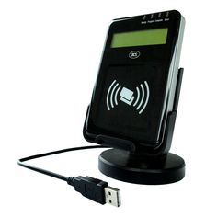
Our Process
Bus Station / Office
3. Get on bus
4. Give prepaid ticket to staff
1. Buy card
2. Receive card
5. Receive bus ticket
Student A
Notes:
Sử dụng vé tháng
Muốn có vé tháng
Đến trụ sở hoặc bến xe để mua
Nhận 1 tập vé từ nhân viên
Lên xe buýt
Đưa vé tháng cho nhân viên
Nhận lại 1 vé xác nhận
=>

Slide 27
Our Process
Bus Station / Office
1. Buy card
3. Get on bus
4. Tap card
2. Receive card
Student A
Notes:
Sử dụng vé tháng
Muốn có vé tháng
Đến trụ sở hoặc bến xe để mua
Nhận 1 tập vé từ nhân viên
Lên xe buýt
Đưa vé tháng cho nhân viên
Nhận lại 1 vé xác nhận
=>

Slide 28

Our proposal - Summary
Center management application
Simulation for publishing card or reading card
Web application
NFC writer/reader
Deliver to passenger
Passenger’s application
NFC card
Mobile application

Slide 29

Technology
Use short-range radio-frequency identification technology (RFID) technologies
Near Field Communication

Slide 30
Technology
Use short-range radio-frequency identification technology (RFID) technologies
Exchange data within 4 cm or less
Near Field Communication

Slide 31
Technology
Use short-range radio-frequency identification technology (RFID) technologies
Exchange data within 4 cm or less
Supply power to and communicate with an unpowered and passive electronic tag
Near Field Communication

Slide 32

Main features
1. Publish Card
2. Buy Ticket
3. Manage
- Card
- Ticket
- Account
4. View Report

Slide 33
Main features
1. Publish card

Slide 34
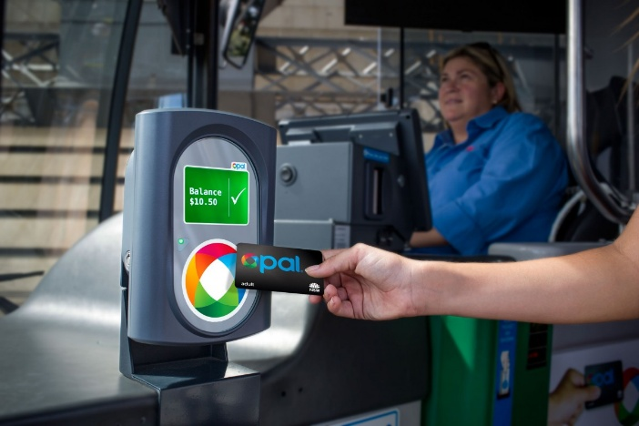
Main features
2. Buy ticket
By card

Slide 35
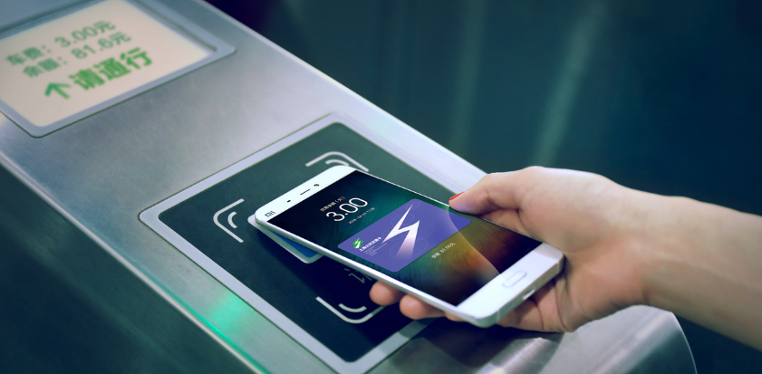
Main features
2. Buy ticket
By card
By phone

Slide 36
Main features
2. Buy ticket
By card
By phone

Slide 37
Main features
3. Manage

Slide 38
Main features
3. Manage
Card

Slide 39

Main features
3. Manage
Card
Account

Slide 40
Main features
3. Manage
Card
Account
Ticket

Slide 41

Main features
4. View report

Slide 42
Main features
4. View report
Passenger
- Outcome report

Slide 43
Main features
4. View report
Passenger
- Outcome report
Manager
- Income report

Slide 44
Features Explanation

Slide 45
Card
NFC card

Slide 46
Card
Card
UniqueIdentifier
Manufacturer ID
NFC card

Slide 47
Card
Card
UniqueIdentifier
Balance
NFC card

Slide 48
Card
Card
UniqueIdentifier
Balance
Status
NFC card

Slide 49
Card
Card
UniqueIdentifier
Balance
Status
UserID
NFC card

Slide 50
Card
Card
ID
UniqueIdentifier
Balance
Status
UserID
NFC card

Slide 51
Ticket

Slide 52
Ticket
Ticket
ID

Slide 53
Ticket
Ticket
ID
CardID

Slide 54
Ticket
Ticket
ID
TicketType
CardID
ID
TicketTypeID
…

Slide 55
Ticket
Ticket
ID
CardID
BusRoute
TicketTypeID
ID
BusRouteID
…

Slide 56
Ticket
Ticket
ID
CardID
TicketTypeID
BusRouteID
Total

Slide 57
Ticket
Ticket
ID
CardID
TicketTypeID
BusRouteID
Total
BoughtDate

Slide 58
Ticket
Ticket
ID
CardID
TicketTypeID
BusRouteID
Total
BoughtDate
IsNoCard

Slide 59
User
User
PhoneNumber
User

Slide 60
User
User
PhoneNumber
Password
User

Slide 61
User
User
PhoneNumber
Password
Fullname
User

Slide 62
User
User
PhoneNumber
Password
Fullname
Status
User

Slide 63
User
User
Role
PhoneNumber
ID
Password
Name
Fullname
Status
User
RoleID

Slide 64
Relationship
User
…
Card
…
Ticket
…

Slide 65
Relationship
1
User
…
0..*
Card
…
Ticket
…

Slide 66
Relationship
1
User
…
0..*
Card
1
…
0..*
Ticket
…

Slide 67
Similar System in Australia

Slide 68
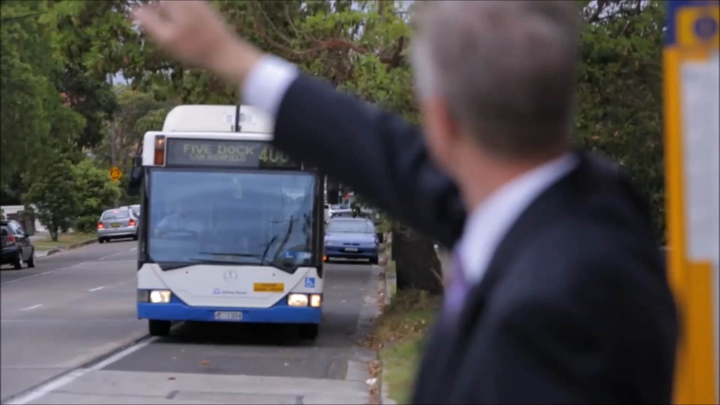

Slide 69
Demo 1

Slide 70
Demo 1’s features
Features
Publish card

Slide 71
Demo 1’s features
Features
Publish card
Buy ticket

Slide 72
Demo 1’s Scenario
Student A goes to school by bus for the first time.
Bus Station / Office
1. Buy card
3. Get on bus
4. Tap card
2. Receive card
Student A

Slide 73
Publish Card

Slide 74
Buy ticket
Tap card on bus emulator

Slide 75
How could we do that?

Slide 76
Publish card

Slide 77
Publish card
Web application
Staff B
1. Log in and go to publish card feature

Slide 78

Publish card
Web application
Staff B
1. Log in and go to publish card feature
2. Tap new card on NFC reader
Emulator

Slide 79
Publish card
Web application
Staff B
1. Log in and go to publish card feature
3. Get card’s ID and send to web application
2. Tap new card on NFC reader
Emulator

Slide 80
Publish card
Web application
Staff B
1. Log in and go to publish card feature
4. Insert new card
GBTS System
3. Get card’s ID and send to web application
2. Tap new card on NFC reader
Emulator

Slide 81
Publish card
Web application
Staff B
1. Log in and go to publish card feature
4. Insert new card
GBTS System
3. Get card’s ID and send to web application
2. Tap new card on NFC reader
Emulator

Slide 82
Buy ticket

Slide 83
Buy ticket
1. Tap card on emulator
Emulator
Passenger

Slide 84
Buy ticket
1. Tap card on emulator
2. Send card’s ID to web service
GBTS System
Emulator
Passenger

Slide 85
Buy ticket
1. Tap card on emulator
2. Send card’s ID to web service
GBTS System
Emulator
3. Check the balance of received card’s ID
Passenger

Slide 86
Buy ticket
1. Tap card on emulator
2. Send card’s ID to web service
GBTS System
4. Return result
Emulator
3. Check the balance of received card’s ID
Passenger

Slide 87
Buy ticket
1. Tap card on emulator
2. Send card’s ID to web service
GBTS System
5. Show result
4. Return result
Emulator
3. Check the balance of received card’s ID
Passenger

Slide 88
Demo 2

Slide 89
Demo 2’s Features
Activate card by SMS

Slide 90
Demo 2’s Features
Activate card by SMS
View report

Slide 91
Demo 2’s Features
Activate card by SMS
View report
Buy ticket by phone

Slide 92
Demo 2’s Features
Activate card by SMS
View report
Buy ticket by phone
Top up by PayPal

Slide 93
Demo 2’s Scenario
Scenario:
Passenger A want to:
View card’s balance

Slide 94
Demo 2’s Scenario
Scenario:
Passenger A want to:
View card’s balance
View usage report

Slide 95
Demo 2’s Scenario
Scenario:
Passenger A want to:
View card’s balance
View usage report
Top up

Slide 96
Demo 2’s Scenario
Scenario:
Passenger A want to:
View card’s balance
View usage report
Top up
Use his/her phone to buy ticket

Slide 97
Demo 2’s Scenario
Scenario:
Passenger A want to:
View card’s balance
View usage report
Top up
Use his/her phone to buy ticket
He/she has to activate his/her card first.

Slide 98
Activate card by SMS

Slide 99
View usage report
Passenger’s screen

Slide 100
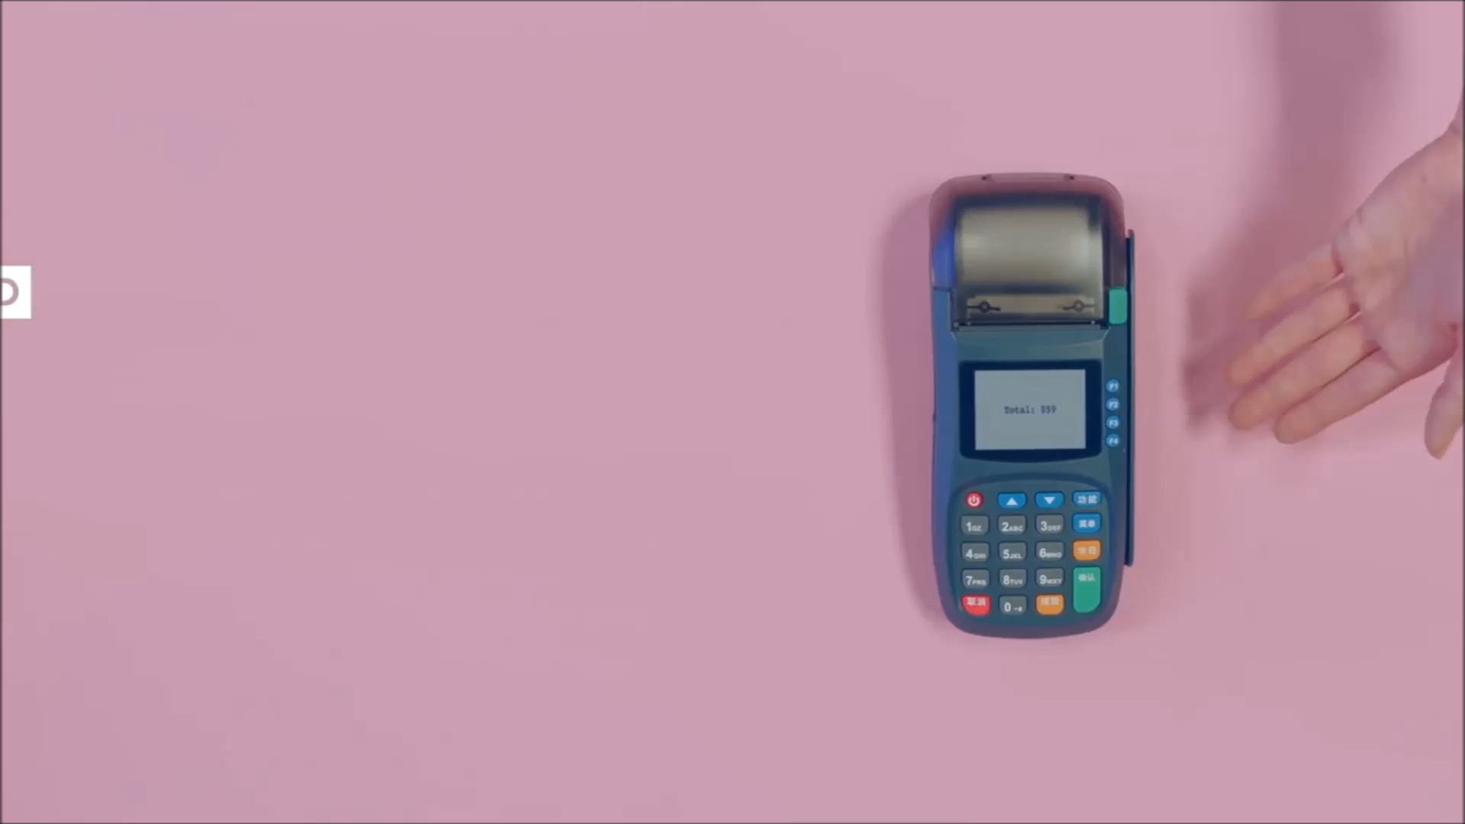
Bus emulator screen
Passenger’s screen

Slide 101
Buy ticket by phone
Bus emulator screen
Passenger’s screen

Slide 102
Top up by PayPal
Passenger’s screen

Slide 103
How could we do that?

Slide 104
Activate card by SMS

Slide 105
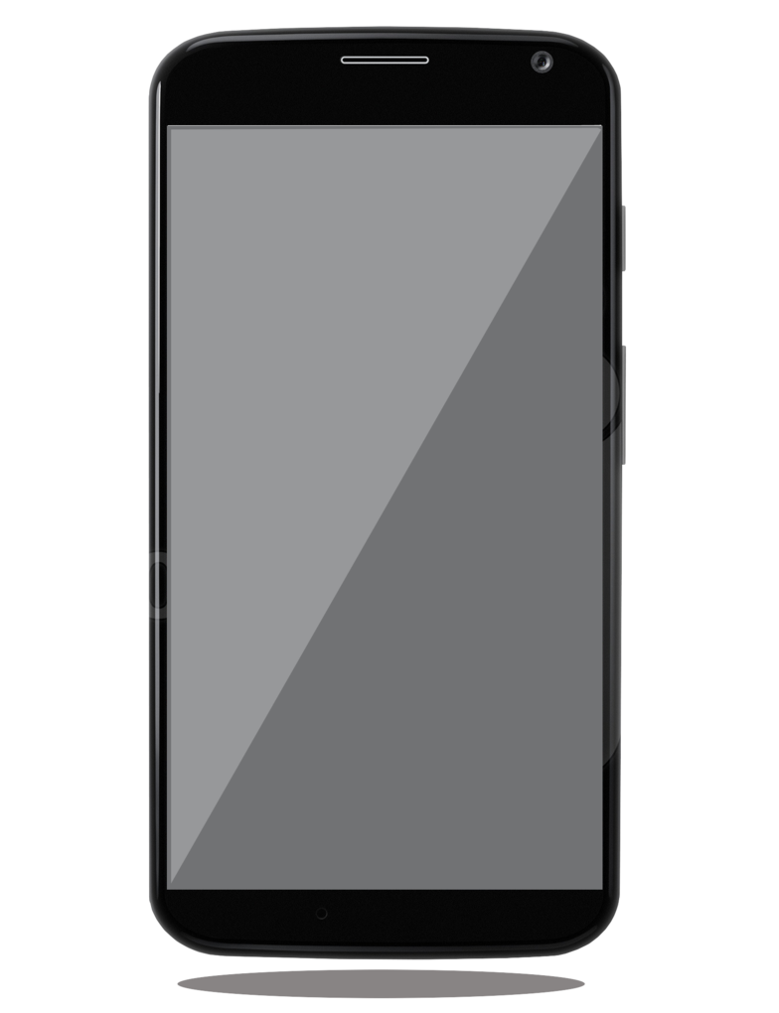
Activate card by SMS
1. Make an SMS with syntax: DK [Card ID] to 19008198
Passenger

Slide 106
Activate card by SMS
1. Make an SMS with syntax: DK [Card ID] to 19008198
2. Send the SMS
GBTS System
Passenger

Slide 107
Activate card by SMS
3. Create new user account
1. Make an SMS with syntax: DK [Card ID] to 19008198
2. Send the SMS
GBTS System
Passenger

Slide 108
Activate card by SMS
3. Create new user account
1. Make an SMS with syntax: DK [Card ID] to 19008198
2. Send the SMS
GBTS System
Passenger
4. Send an SMS with an auto generated password

Slide 109
Buy ticket by phone

Slide 110
Buy ticket by phone
Passenger’s phone
1. Login GBTS mobile app and set a default card to pay
Passenger

Slide 111
Buy ticket by phone
Passenger’s phone
2. Tap phone on emulator to send encrypted data
Emulator
1. Login GBTS mobile app and set a default card to pay
Passenger

Slide 112
Buy ticket by phone
Passenger’s phone
2. Tap phone on emulator to send encrypted data
3. Decrypt data then send to GBTS System
GBTS System
Emulator
1. Login GBTS mobile app and set a default card to pay
Passenger

Slide 113
Buy ticket by phone
Passenger’s phone
4. Check the balance of received card’s ID
2. Tap phone on emulator to send encrypted data
3. Decrypt data then send to GBTS System
GBTS System
Emulator
1. Login GBTS mobile app and set a default card to pay
Passenger

Slide 114
Buy ticket by phone
Passenger’s phone
4. Check the balance of received card’s ID
2. Tap phone on emulator to send encrypted data
3. Decrypt data then send to GBTS System
GBTS System
5. Return result
Emulator
1. Login GBTS mobile app and set a default card to pay
Passenger

Slide 115
Buy ticket by phone
Passenger’s phone
4. Check the balance of received card’s ID
2. Tap phone on emulator to send encrypted data
3. Decrypt data then send to GBTS System
GBTS System
5. Return result
Emulator
1. Login GBTS mobile app and set a default card to pay
6. Show result
Passenger

Slide 116
Buy ticket by phone - Security
Raw data: GB123456 | 201057:201756:29175:30475

Slide 117
Buy ticket by phone - Security
Raw data: GB123456 | 201057:201756:29175:30475
Card’s ID
Token
Is renewed every 1 hour
Token
Auto generated number by server

Slide 118

Buy ticket by phone - Security
Raw data: GB123456 | 201057:201756:29175:30475
Card’s ID
Token
AES Encrypt
Is renewed every 1 hour
Token
Auto generated number by server

Slide 119
Buy ticket by phone - Security
Raw data: GB123456 | 201057:201756:29175:30475
Card’s ID
Token
AES Encrypt
Data to be transfered
Is renewed every 1 hour
Token
Auto generated number by server

Slide 120
Demo 3

Slide 121
Demo 3’s Feature
Manage card

Slide 122
Demo 3’s Scenario
Student A lost his card.
He calls the GBTS hotline and ask the staff to block his card immediately.
After that, he goes to the nearest GBTS office to buy a new card and he want to transfer the money from his lost card to the new one.

Slide 123
Manage Card

Slide 124
Advantages & Disadvantages

Slide 125
Advantages

Slide 126
Advantages
Save time
- Just a tap to buy ticket

Slide 127
Advantages
Save time
- Just a tap to buy ticket
Save money
- Printing cost
- Don’t need a staff on the bus

Slide 128
Advantages
Save time
- Just a tap to buy ticket
Save money
- Printing cost
- Don’t need a staff on the bus
Many support features

Slide 129
Advantages
Save time
- Just a tap to buy ticket
Save money
- Printing cost
- Don’t need a staff on the bus
Many support features
- Top up in many ways:
PayPal, cash, scratch card

Slide 130
Advantages
Save time
- Just a tap to buy ticket
Save money
- Printing cost
- Don’t need a staff on the bus
Many support features
- Top up in many ways:
PayPal, cash, scratch card
- Block card when lost

Slide 131
Advantages
Save time
- Just a tap to buy ticket
Save money
- Printing cost
- Don’t need a staff on the bus
Many support features
- Top up in many ways:
PayPal, cash, scratch card
- Block card when lost
- Recover the remaining funds

Slide 132
Advantages
Save time
- Just a tap to buy ticket
Save money
- Printing cost
- Don’t need a staff on the bus
Many support features
- Top up in many ways:
PayPal, cash, scratch card
- Block card when lost
- Recover the remaining funds
- Spending tracking

Slide 133
Advantages
Save time
- Just a tap to buy ticket
Save money
- Printing cost
- Don’t need a staff on the bus
Many support features
- Top up in many ways:
PayPal, cash, scratch card
- Block card when lost
- Recover the remaining funds
- Spending tracking
- Notification when card runs out of money

Slide 134
Advantages
Save time
- Just a tap to buy ticket
Save money
- Printing cost
- Don’t need a staff on the bus
Many support features
- Top up in many ways:
PayPal, cash, scratch card
- Block card when lost
- Recover the remaining funds
- Spending tracking
- Notification when card runs out of money
- Promotion offer

Slide 135
Disadvantages

Slide 136
Disadvantages
The system currently supports Android OS
Buses in Ho Chi Minh city only

Slide 137
Future’s Plans

Slide 138



Future’s plans
Support
Android Smartphone
iOS Smartphone

Slide 139

Future’s plans
Ho Chi Minh City

Slide 140



Future’s plans
One card for all public transportation
City Bus
Train
Subway Train

Slide 141


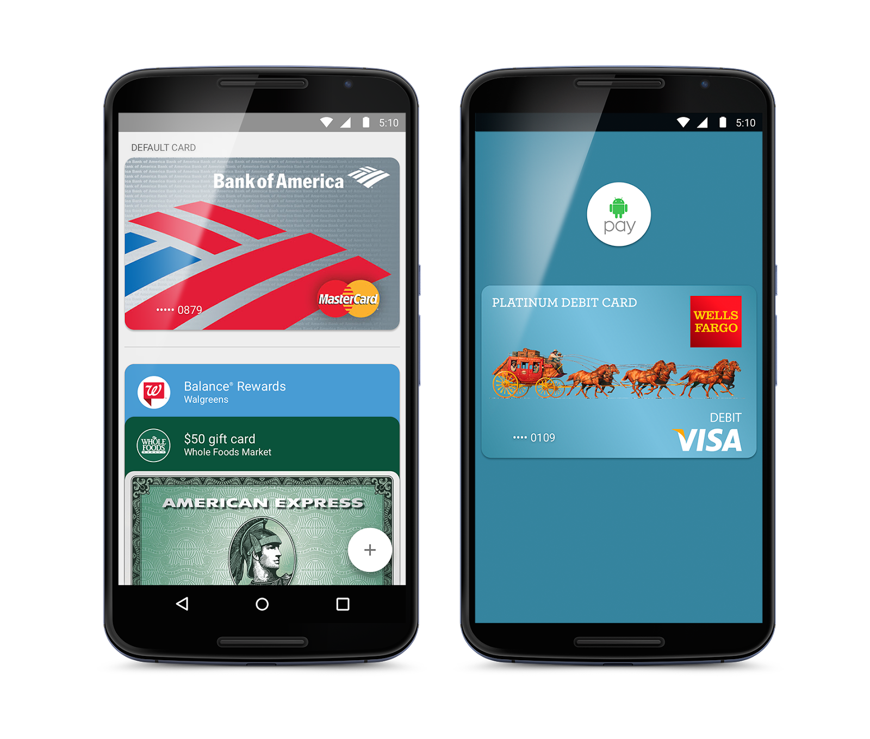
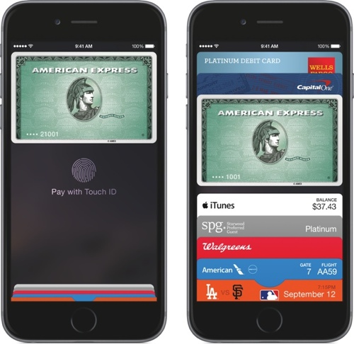
Future’s plans
Buy ticket by phone

Slide 142


Slide 143
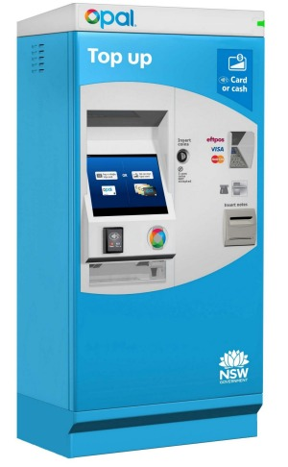
Future’s plans
Install top up machines at bus stops

Slide 144



Future’s plans
Install top up application at convenience stores

Slide 145
Thank you for your listening

